Slide 1
The Phoenix Force
The Student Recreation Center
Tierra Binford, Jade Brown, Keith Camp, Noah Smith, Elise Timmons, Levi Walton

Slide 2
Key Points
Problem Statement
Stakeholder Analysis
Feasibility Considerations
Technical Feasibility
Benefits
Architecture Considerations
System Requirements
Risk Analysis
Use Cases
Prototypes
Numbers

Slide 3
Problem Statement
This project will help solve the locker, email, and user problems. Currently, email addresses are written on paper and sometimes users emails are entered wrong and they don’t get updates. The new system will allow users to enter their information online.
The Problem Of: The SRC is currently using paper to do most of their documentation.
Affects: Expired lockers still have customer items in them.
The Impact Of Which Is: Users don’t know when their lockers expire and lose their personal items.
A Successful Solution Should Be: Create a registration system that can be used to better notify users of their locker status.

Slide 4
Product Position Statement
We want our project to improve the workflow of the Student Recreation Center. We strive to provide all of the features needed to bring the workflow to the highest levels possible. Hopefully, by the end our clients are completely satisfied.
For: The Student Recreation Center
Who: Improve the user and worker experience.
The (Product Name): Is a web application.
That: Will make it easier for the SRC to do business.

Slide 5
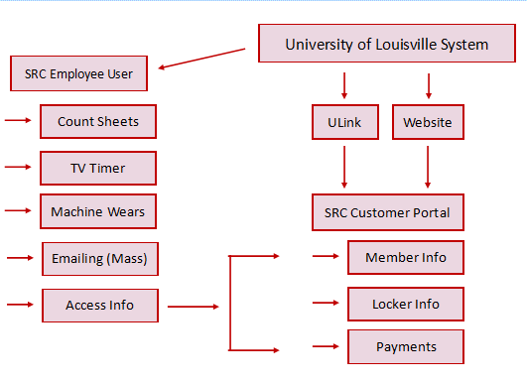
Product Overview

Slide 6
Product Features
Allow for SRC staff to maintain client locker rental [priority]
Allow for SRC staff to track machine maintenance [priority]
Allow for SRC staff to track machine usage [priority]
Allow for SRC staff to track usage of SRC facilities demographically [priority]

Slide 7
Product Requirements
Content management system, used to manage web interface.
Payment management system, used to allow clients to regulate payment for locker rentals.
Database system, used to store locker rental data, machine management and usage data.
Devices for SRC staff, used to manipulate the data for locker rentals and machine usage and management data.

Slide 8
Stakeholder Analysis
Non - user stakeholders
SRC Top Management - the stakeholders that realized there is an issue and are expecting a solution
User stakeholders
Employees - the stakeholders that will be actually using the system
Locker Users - the stakeholders that will benefit from the proposed locker solution
Customers - the stakeholders that are expecting the most for their money’s worth
Potential Customers - the stakeholders that are seeing what they could potentially get for their money

Slide 9
Stakeholder Needs
Locker Rental
Better maintain tracking of locker rentals in a centralized system to each registered member
Some type of reminder (email) when membership is about to expire
Track Machine Maintenance
Automate and track the maintenance and repairs on gym equipment (life cycle)
Track Machine Usage
Track how much the machines are being used
Track SRC Facilities Usage demographically
To conduct an analysis on which type of members use the SRC
Will help the SRC to appeal to their members more based on their demographics

Slide 10
Feasibility Considerations
Operational:
The SRC wishes to find ways to make their operations run smoother, this will be done by creating and updating a website. Our goals are to help enhance the SRC’s website and maximize efficiency. Our aligned goal will allow us to meet the wishes of the SRC.
Other:
If machine wearforms cannot be automated, system that can read reports will be needed.
If count sheets cannot be automated, system that can read reports will be needed.
If TV’s cannot connect to one universal control, new TV’s that can should be purchased.

Slide 11
Technical Feasibility
Familiarity with function area:
Understanding the needs of the SRC being familiar with their business function area.
Familiarity with technology:
Requires some training to use and understand the new system
The website will be designed to allow novice users to easily navigate the system (User-friendly).
Project Size:
The project is large in comparison to the system that is currently implemented.
The new site will integrate newer more complex features that will enhance the users experience as well as the SRC’s ability to perform their business functions online.
Compatibility:
The current system used by the SRC is not currently online.
The new system will be incompatible with the old system.

Slide 12
Economic Costs and Benefits
Development Costs: Hardware, CMS, Developmental Labor
Operational Costs: Software, Operational labor
Tangible Benefits: Increased Members, Increased Revenue, Increased Productivity
Intangible Benefits: Name Recognition, Customer Satisfaction

Slide 13
Operational Feasibility
For smoother operations, create and update website in order to
The SRC wishes to find ways to make their operations run smoother, this will be done by creating and updating a website. Our goals are to help enhance the SRC’s website and maximize efficiency. Our aligned goal will allow us to meet the wishes of the SRC

Slide 14
Architecture Considerations
WordPress - system allows for lots of different content to be modified. WordPress also gives many different templates that can be used to create websites. An effective design will also help to make the system more efficient.
PayPal: system to process payments. Safe and secure site.Gives records of all processed payments. $30 a month to add PayPal to website, or an additional 2.9% charge per transaction.

Slide 15
System Requirements
Non-Functional
Functional
Operational:
Handheld devices will be needed to survey demographics
PCs - Windows
Performance:
Tablet app for surveying will need to be collaborative
PCs will be able to support multiple users
Security:
Employees should not be able to access complete customer account information
Customers
Memberships
Workout Machine Maintenance
Demographic Surveying
Member Registration
Locker Rentals
Email Blast
Reporting
Email Blast

Slide 16
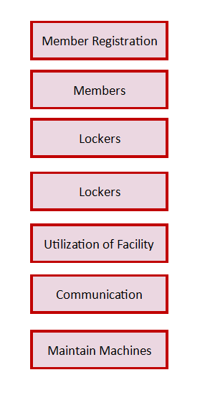
As-is
To-be

Slide 17
Use Cases
Use Case Name: Member Registration Primary Actor: Member Description: This use case describes how users can go on the site and register to be a member.
Use Case Name: System Reporting Primary Actor: SRC staff Description: This use case describes how the SRC staff can use the CMS to export a monthly report of active memberships and filter out ones that are about to expire.
Use Case Name: Email Blast Primary Actor: SRC Staff Description: This use case describes how the SRC employee will be able to use the CMS to initiate and send out Email Blasts to members (i.e. locker rental & membership dues).

Slide 18
Risk Analysis
High Risk Cases: Students, Locker Rentals, System Reporting
Low Risk Cases: Television Timer, Reclaimed Lockers
Criteria: Based on most economic benefit.
High risk - saves more money, increased productivity & is higher priority. Low risk - still saves money and productivity just not as much as high-risk.
Risk can be used during the elaboration phase by considering the use case(s) that are high risk that would contribute the most to the system.

Slide 19
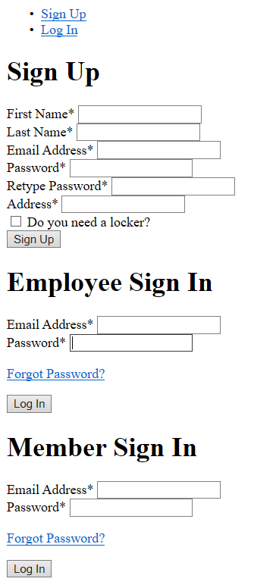
Prototype

Slide 20
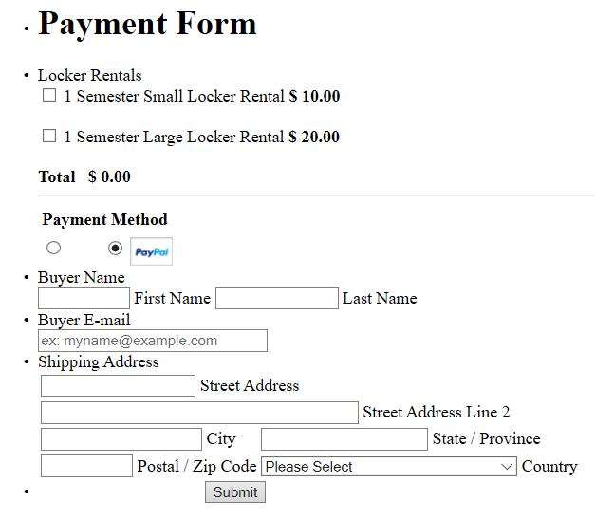

Prototype

Slide 21
Numbers
Business Analyst (2) | 33,446.40
Project Manager | 28,508.48
Dev Employee (2) | 42,240.64
Database Administrator | 18,016.96
Total Dev Costs | $122,212.48
Total Benefits: $258,645.73
Total Dev Cost: $122,212.48
Total Annual Cost: $45,542.15
Total Cost: $167,754.63
ROI: 0.54
Paper | 566.32
Ink | 77.20
Printer Maintenance | 1,907.06
Database System | 18,105.20
Content Management System | 12,415.00
Payment System | 170.19
Domain | 56.90
Cloud | 12,244.29
Total Annual Costs | $45,542.15

Slide 22
Review
What are the problems?
What are the answers?
How will we provide the answers?

Slide 23
Any Questions?

